Slide 1
22
The CPI and the Cost of Living
Goals:
  1 Explain what the Consumer Price Index (CPI) is and how it is calculated.
  2 Explain the limitations of the CPI and describe other measures of the price level.
  3 Adjust money values for inflation and calculate real wage rates and real interest rates.
Notes:
Notes and teaching tips: 9, 11, 15, 22, 39, and 45.
To view a full-screen figure during a class, click the red “expand” button.
To return to the previous slide, click the red “shrink” button.
To advance to the next slide, click anywhere on the full screen figure.
To enhance your lecture, check out the Lecture Launchers, Land Mines, and Class Activities in the Instructor’s Manual.

Slide 2
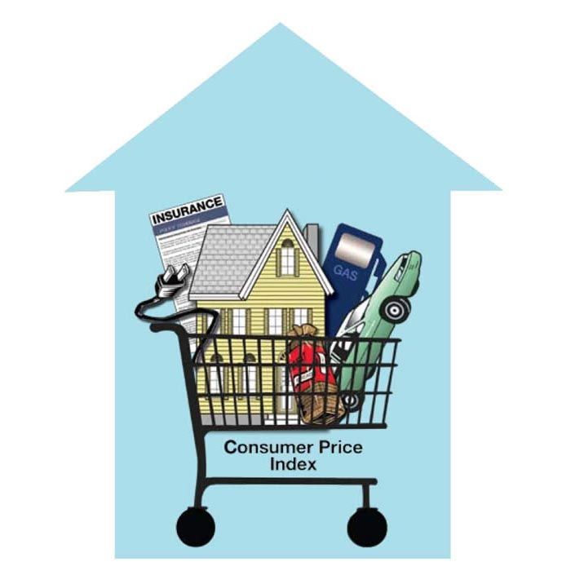
  Consumer Price Index (CPI) is a measure of the average of the prices paid by urban consumers for a fixed market basket of consumer goods and services.
  The BLS calculates the CPI every month.
  We can use these numbers to compare what a fixed basket of goods costs this month with what it cost in some previous month.

Slide 3
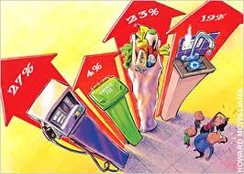
The CPI is defined to equal 100 for a period called the reference base period.
Reference base period is a period for which the CPI is defined to equal 100.
Currently, the reference base period is 1982−1984.

Slide 4
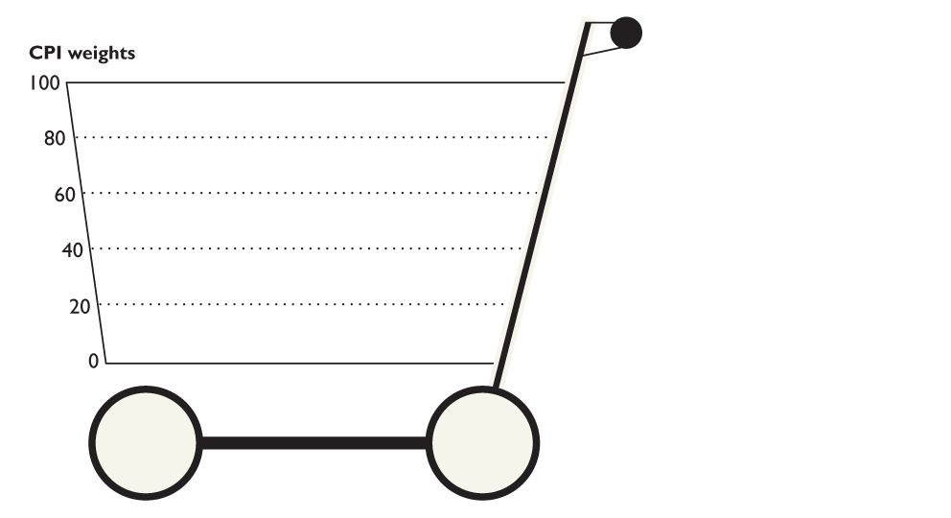
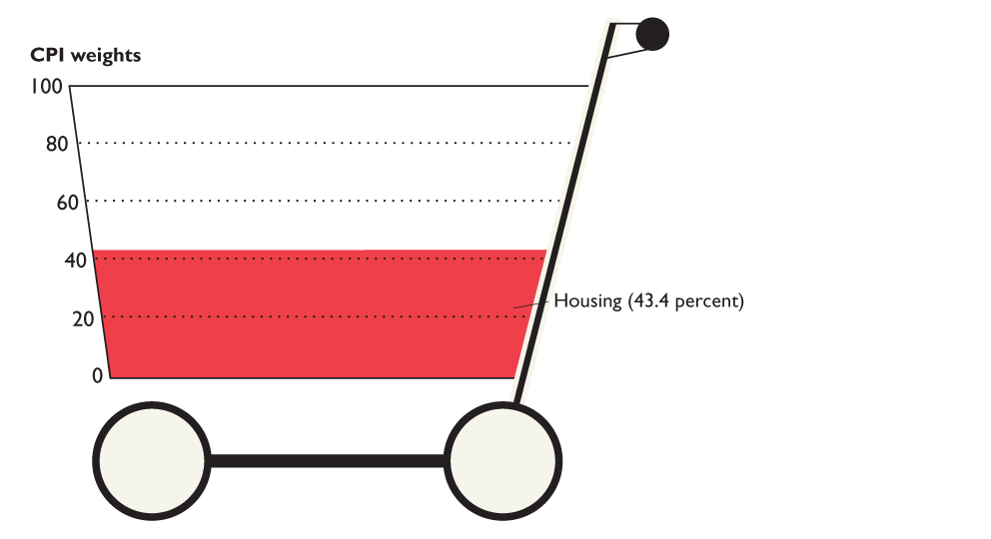
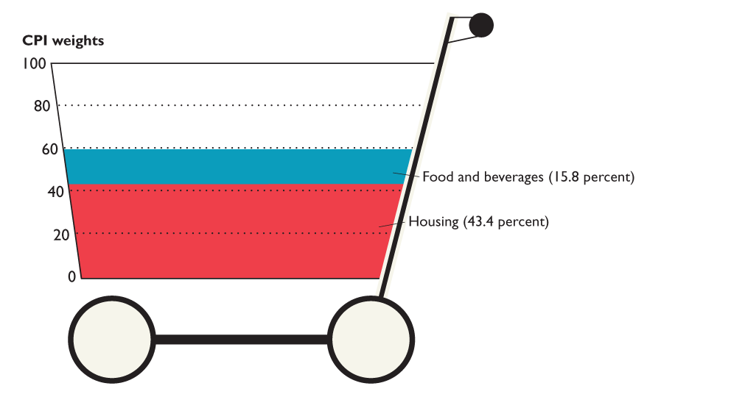
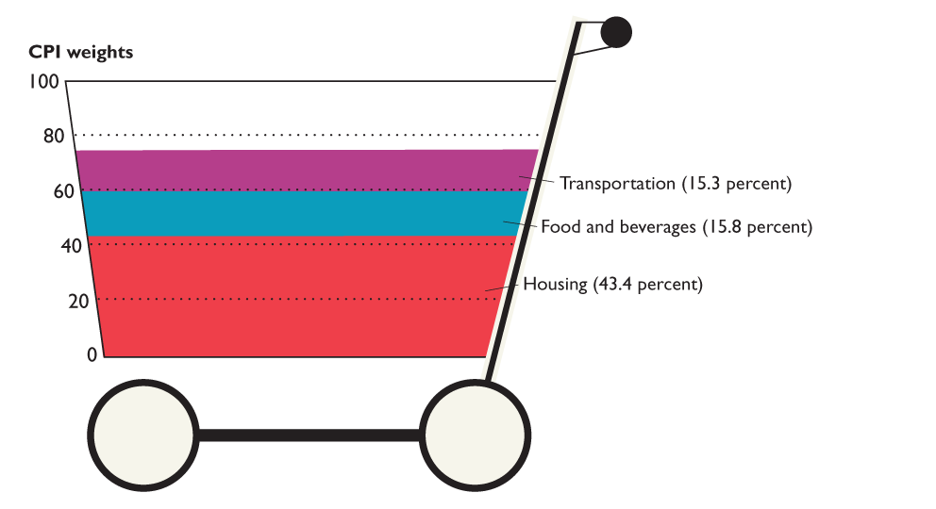
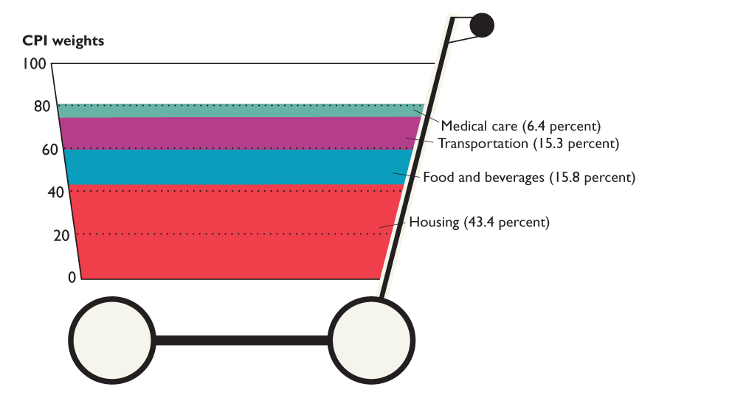
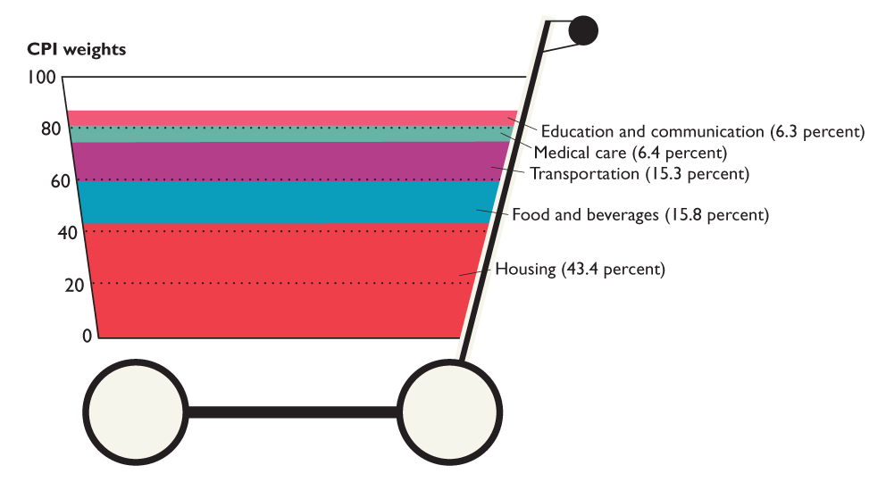
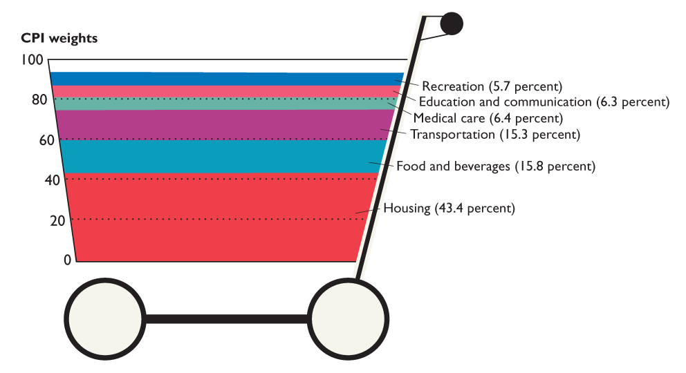
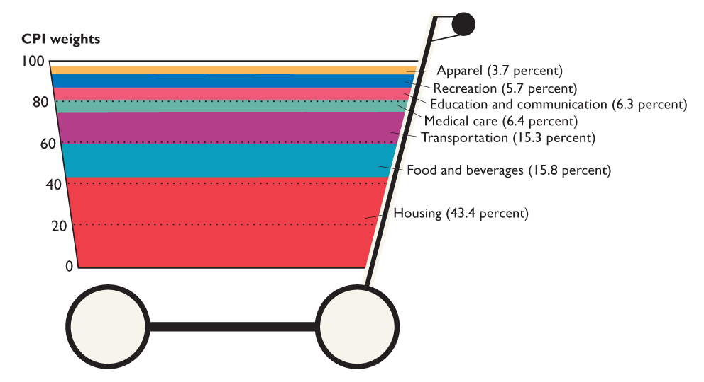
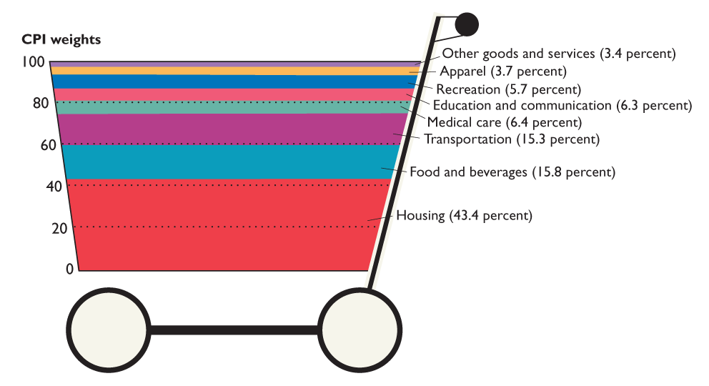
Figure 22.1 shows the CPI basket at the end of 2008.
This shopping cart is filled with the items that an average household buys.
Notes:
Ask your students to make an estimate of their own baskets and compare them with the BLS basket.

Slide 5

The Monthly Price Survey
  Each month, BLS employees check the prices of the 80,000 goods and services in the CPI basket in 30 metropolitan areas.
  Because the CPI measures price changes, it is important that the prices recorded refer to exactly the same items.
Notes:
Surveying college textbook prices might capture the students’ attention. (See the IM for a detailed discussion).

Slide 6
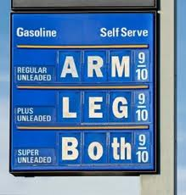
22.1 THE CONSUMER PRICE INDEX
The CPI calculation has three steps:
Find the cost of the CPI basket at base period prices.
Find the cost of the CPI basket at current period prices.
Calculate the CPI for the base period and the current period.

Slide 7
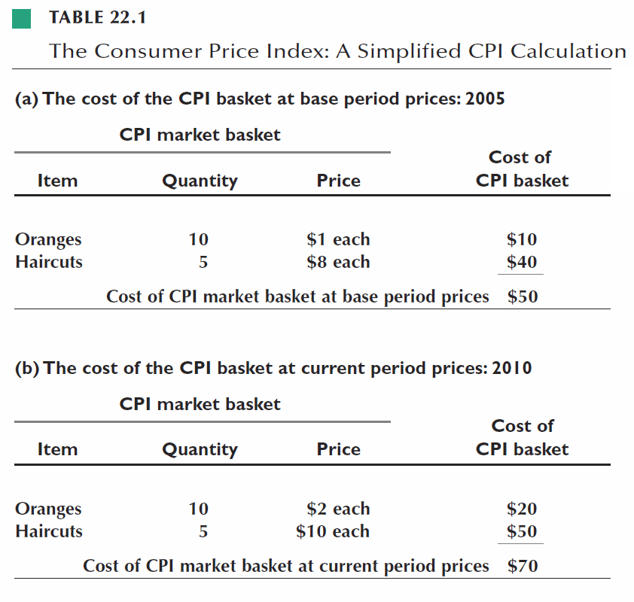
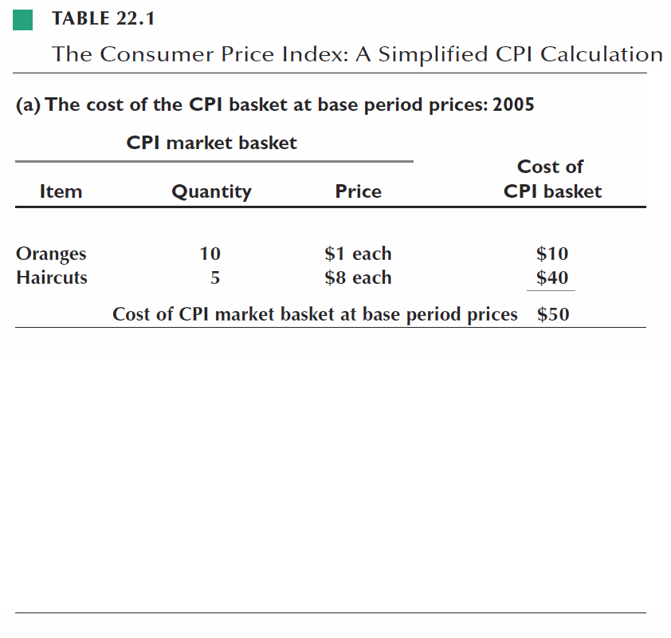
22.1 THE CONSUMER PRICE INDEX

Slide 8
22.1 THE CONSUMER PRICE INDEX
Cost of CPI basket at current period prices
CPI =
x 100
Cost of CPI basket at base period prices
$50
For 2005, the CPI is:
x 100
= 100
$50
$70
For 2010, the CPI is:
x 100
= 140
$50

Slide 9
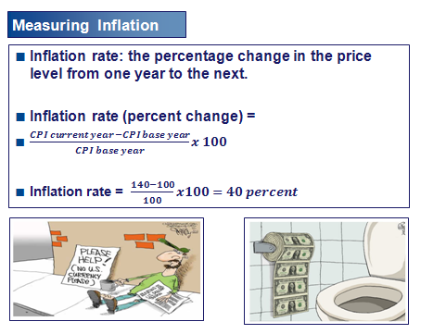

Slide 10
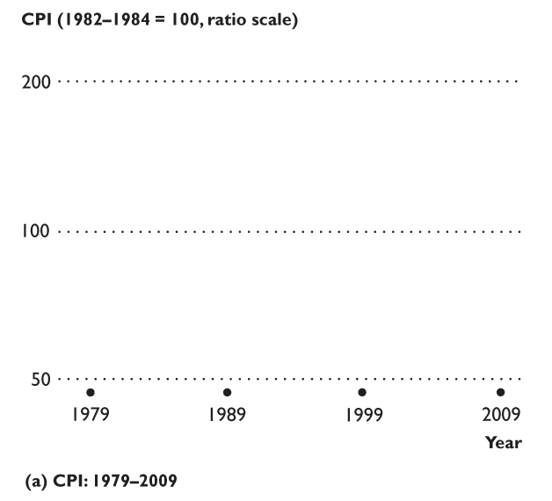
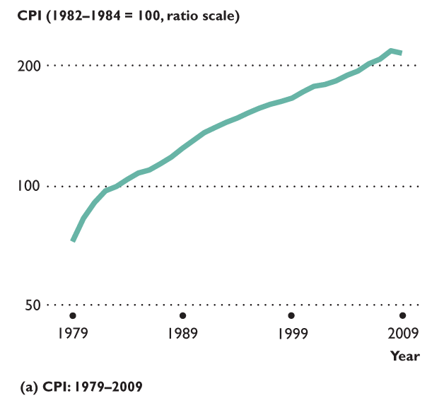
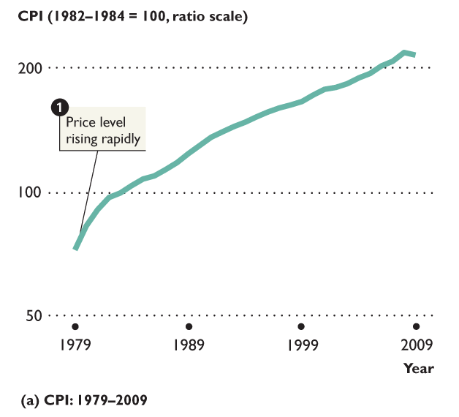
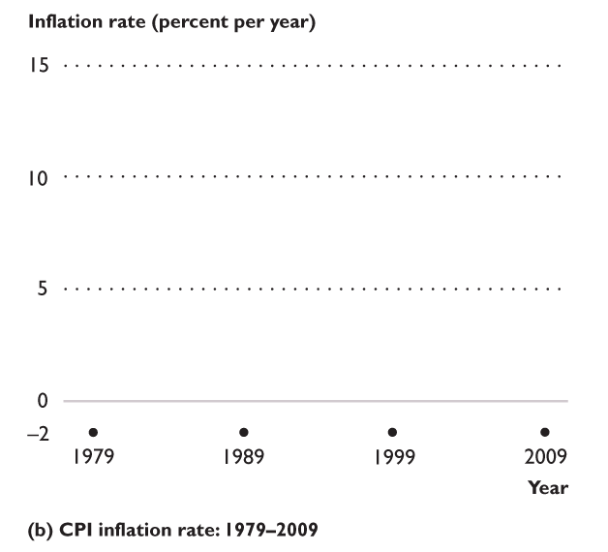
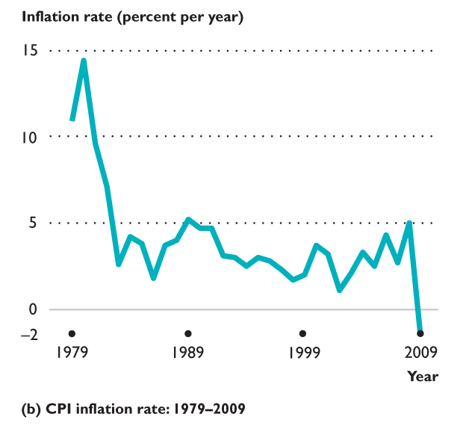
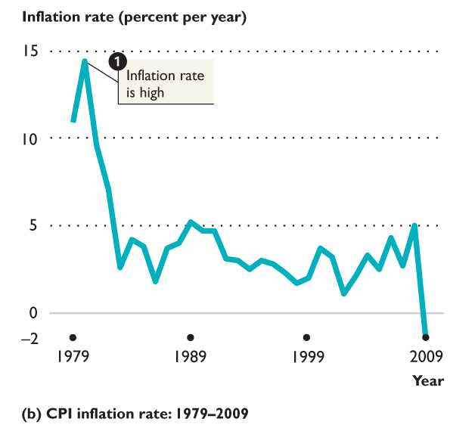
22.1 THE CONSUMER PRICE INDEX
1. The price level has rising rapidly in the 1980s and the inflation rate was high.

Slide 11
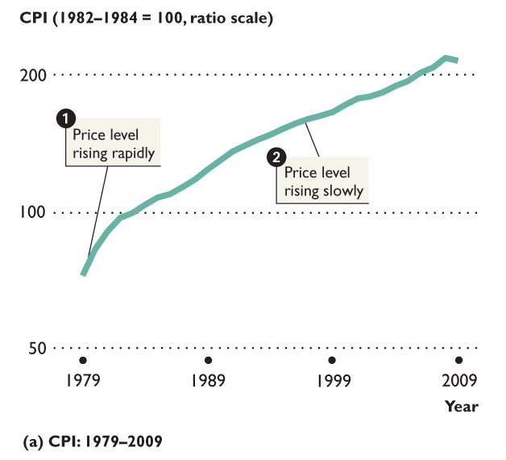
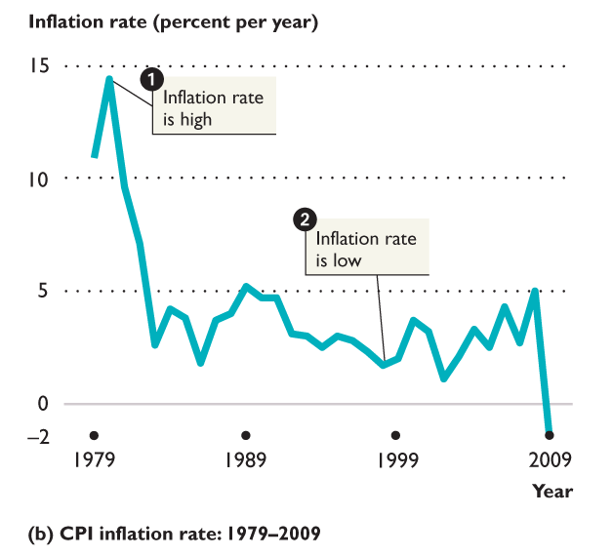
22.1 THE CONSUMER PRICE INDEX
2. The price level was rising slowly during the 1990s and 2000s and the inflation rate was low.

Slide 12
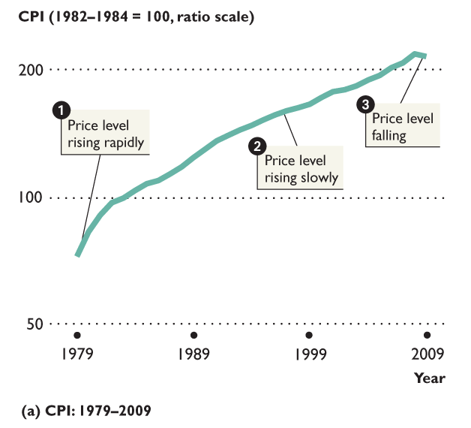
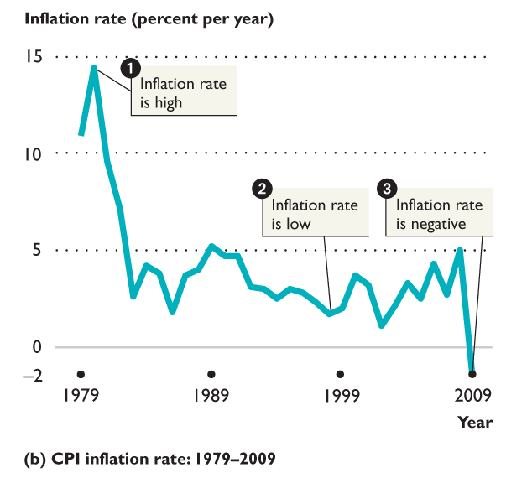
22.1 THE CONSUMER PRICE INDEX
3. In 2009, the price level fell and the inflation rate was negative.

Slide 13

22.2 THE CPI AND OTHER PRICE LEVEL MEASURES
  Cost of living index is a measure of changes in the amount of money that people would need to spend to achieve a given standard of living.
  The CPI does not measure the cost of living because
    It does not measure all the components of the cost of living
    Some components are not measured exactly
  So the CPI is possibly a biased measure. Estimated at an additional 1.1 percent per year above real inflation.

Slide 14

22.2 THE CPI AND SOURCES OF BIAS
  New Goods Bias
    New goods do a better job than the old goods that they replace, but cost more.
    The arrival of new goods puts an upward bias into the CPI and its measure of the inflation rate.
  Quality Change Bias
    Better cars and televisions cost more than the versions they replace.
    A price rise that is a payment for improved quality is not inflation but might get measured as inflation.

Slide 15

22.2 THE CPI AND SOURCES OF BIAS
  Commodity Substitution Bias
    If the price of beef rises faster than the price of chicken, people buy more chicken and less beef.
    The CPI basket doesn’t change to allow for the effects of substitution between goods.
  Outlet Substitution Bias
    If prices rise more rapidly, people use discount stores more frequently.
    The CPI basket doesn’t change to allow for the effects of outlet substitution.

Slide 16

22.2 THE CPI AND OTHER PRICE LEVEL MEASURES
  The GDP price index is an average of current prices of all the goods and services included in GDP expressed as a percentage of base-year prices.
  GDP price index = (Nominal GDP ÷ Real GDP) × 100.
  The GDP price index is a measure of the price level.
  The percentage change in the GDP price index is a measure of the inflation rate.

Slide 17

22.2 THE CPI AND OTHER PRICE LEVEL MEASURES
Two differences between the GDP price index and the CPI result in different estimates of the price level and inflation rate.
  1. The GDP price index uses the prices of all the goods and services in GDP.
  The CPI uses prices of consumption goods and services.
  The GDP price index weights each item using information about current as well as past quantities.
  In contrast, the CPI weights each item using information from a past Consumer Expenditure Survey.

Slide 18
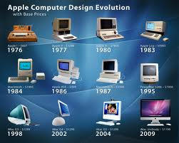
  Because the GDP price index uses information on current year quantities, it includes new goods and quality improvements and even allows for substitution effects of both commodities and retail outlets.
  So in principle, the GDP price index is not subject to the biases of the CPI.

Slide 19

22.2 THE CPI AND OTHER PRICE LEVEL MEASURES
  The PCE price index is an average of current prices of all the goods and services included in the consumption expenditure component of GDP expressed as a percentage of base-year prices.
  The PCE price index, like the GDP price index, uses current information on quantities and prices and to some degree overcomes the sources of bias in the CPI.
  Because it focuses on consumption expenditure, its a possible measure of the cost of living.

Slide 20

22.2 THE CPI AND OTHER PRICE LEVEL MEASURES
  PCE Price Index Excluding Food and Energy
  Food and energy prices fluctuate much more than other prices, so their changes can obscure the underlying trends in prices.
  By excluding these highly variable items, the underlying price level and inflation trends can be seen more clearly.
  The percentage change in the PCE price index excluding food and energy is called the core inflation rate.

Slide 21
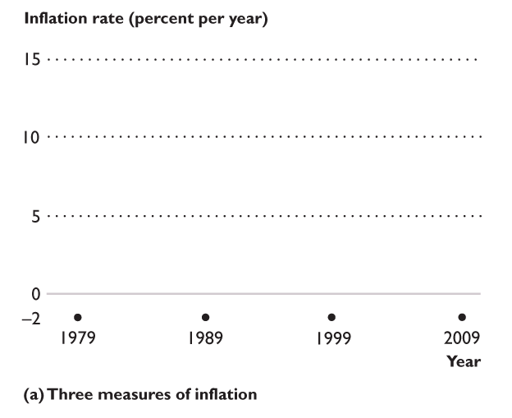
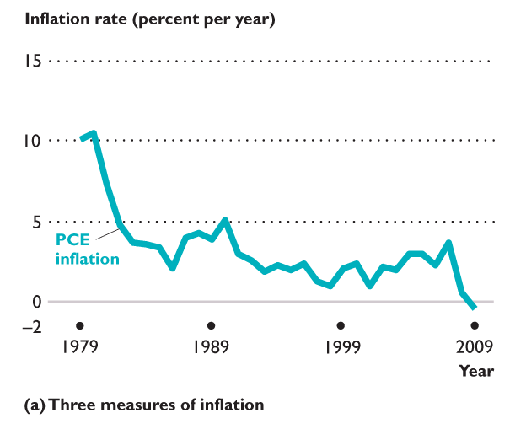
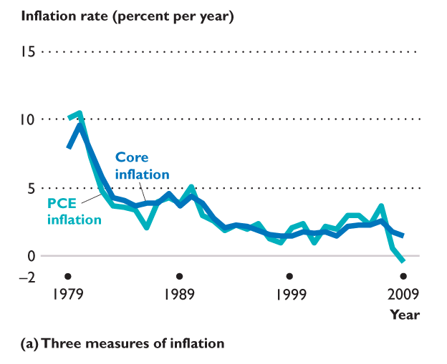
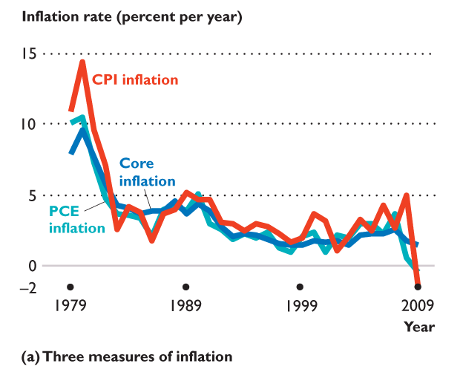
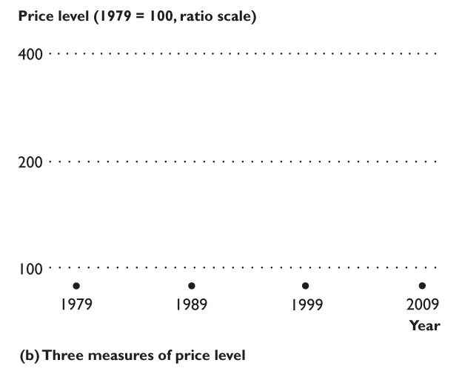
22.2 THE CPI AND OTHER …
Figure 22.3 shows the three measures of the price level and their inflation rates.
The three measures of the inflation rate fluctuate together, but the CPI inflation rate is higher than the other two measures.
The core inflation rate fluctuates less than the other two measures.

Slide 22
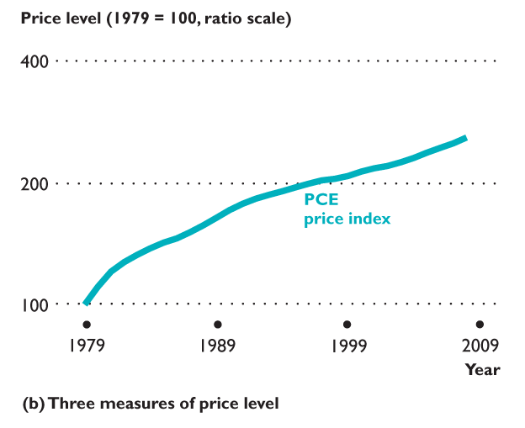
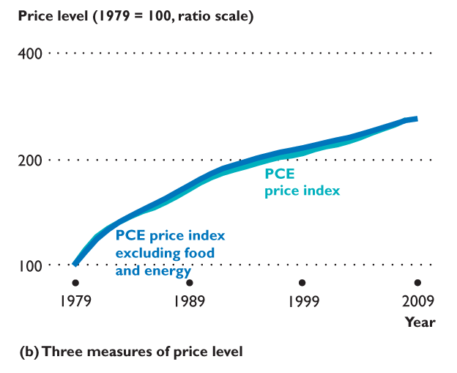
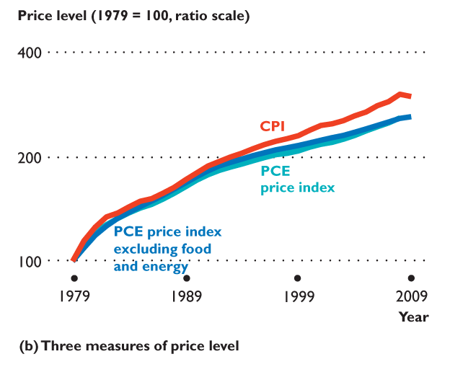
22.2 THE CPI AND OTHER …
Part (b) shows the three measures of the price level.
The CPI increases more quickly than the two PCE measures.
The path of the CPI shows the bias in the CPI as a measure of the price level.

Slide 23


22.3 NOMINAL AND REAL VALUES
Dollars and Cents at Different Dates
  To compare dollar amounts at different dates, we need to know the CPI at those dates.
  Convert the price of a 2¢ stamp in 1909 into its 2009 equivalent:
Price of stamp in 2009 dollars =
CPI in 2009
Price of stamp in 1909 dollars
x
CPI in 1909
214.5
= 2¢ x
= 44.69¢
9.6
Notes:
Spend time helping students appreciate the distinction between real values and nominal values.

Slide 24
EYE on the VALUE OF MONEY
How Do We Measure the Changing Value of Money?
We measure the changing value of money by using a price index.
The most common price index is the CPI.
Because the CPI is biased, we supplement it with other indexes and other information.
By using a price index, we can calculate the amount that a movie really earns at the box office.
Notes:
24

Slide 25
EYE on the VALUE OF MONEY
How Do We Measure the Changing Value of Money?
Gone with the Wind was made in 1939 and rereleased in nine subsequent years.
By 2009, it had earned a total box office revenue of $198,676,459 (almost $200 million) in the United States.
Transformers: Revenge of the Fallen was released in 2009.
During the summer of 2009, it earned $397,470,858 (almost $400 million).
Which movie earned the more box office revenue?
Notes:
25

Slide 26
EYE on the VALUE OF MONEY
How Do We Measure the Changing Value of Money?
To convert the Gone with the Wind revenues into 2009 dollars, …
multiply the dollars received each year by the 2009 CPI and divide by the CPI for the year in which the dollars were earned.
Box-Office Mojo has done such a calculation, but rather than use the CPI, it used the average prices of movie tickets.
According to Box-Office Mojo, valuing the tickets for Gone with the Wind at 2009 movie-ticket prices, it has earned $1,450,680,400, or $1,451million, about 3.6 times Transformers’ revenue.
Notes:
26

Slide 27
EYE on the VALUE OF MONEY
How Do We Measure the Changing Value of Money?
Because Box-Office Mojo uses average ticket prices, the real variable that it compares is the number of tickets sold.
The average ticket price in 2009 was $7.18, so 202 million movie-goers have seen Gone with the Wind and 55 million have seen Transformers: Revenge of the Fallen.
Notes:
27

Slide 28
22.3 NOMINAL AND REAL VALUES
Nominal and Real Values in Macroeconomics
  Macroeconomics makes a big issue of the distinction between nominal values and real values:
    Nominal GDP and real GDP
    Nominal wage rate and real wage rate
    Nominal interest rate and real interest rate
  We studied the distinction between and calculation of nominal and real GDP in Chapter 20. Here, we’ll look at the other two.

Slide 29
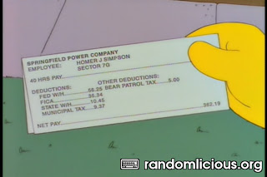
22.3 NOMINAL AND REAL VALUES
Nominal and Real Wage Rates
  Nominal wage rate is the average hourly wage rate measured in current dollars.
  Real wage rate is the average hourly wage rate measured in the dollars of a given reference base year.
Notes:
Use the US President example to emphasize the difficulty of holding relevant factors constant to calculate a real wage.

Slide 30
22.3 NOMINAL AND REAL VALUES
To calculate the real wage rate, we divide the nominal wage rate by the CPI and multiply by 100.
That is,
Nominal wage rate in 2008
Real wage rate in 2008 =
x 100
CPI in 2008
$18.00
Real wage rate in 2008 =
x 100
= $8.36
215.3
The $8.36 amount is in 1982−1984 dollars.

Slide 31
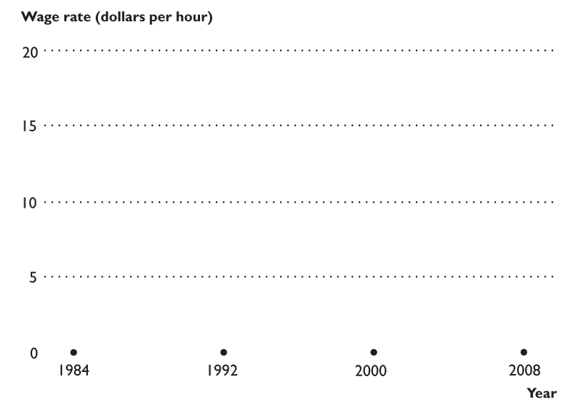
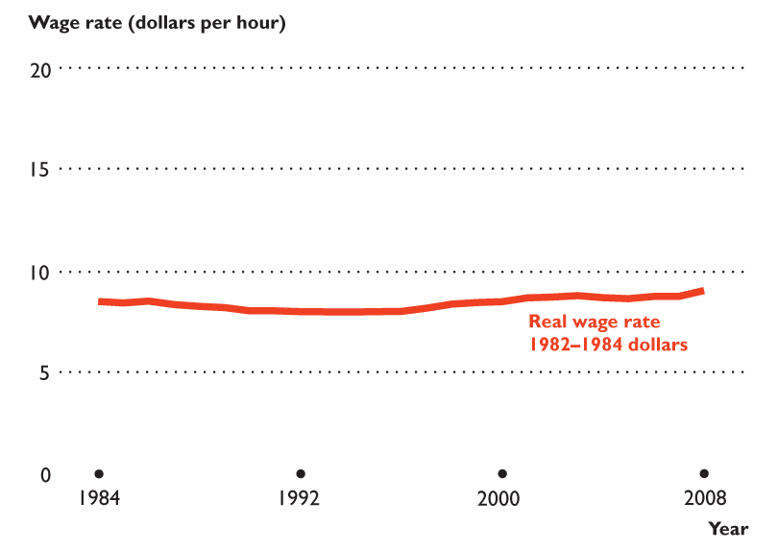
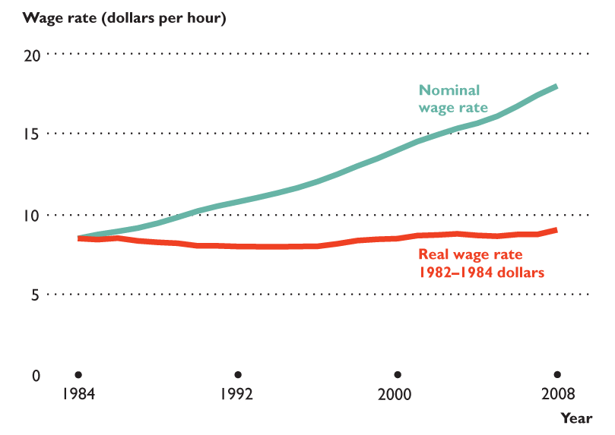
22.3 NOMINAL AND REAL VALUES
Figure 22.4 shows nominal and real wage rates: 1984 to 2008.
Since 1984, the real wage rate barely changed,
Despite the increase in the nominal wage rate every year.

Slide 32
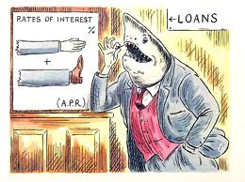
22.3 NOMINAL AND REAL VALUES
Nominal and Real Interest Rates
  Nominal interest rate is the dollar amount of interest expressed as a percentage of the amount loaned.
  Real interest rate is the goods and services forgone in interest expressed as a percentage of the amount loaned.
  Real interest rate = Nominal interest rate – Inflation rate.

